Slide 1
Movie Genre Classification from Movie Posters
Siddhartha Gairola

Slide 2
Project Goal
The aim of this project is to classify and predict the genre of a movie based purely on the corresponding movie poster without any prior knowledge or context of origin.

Slide 3
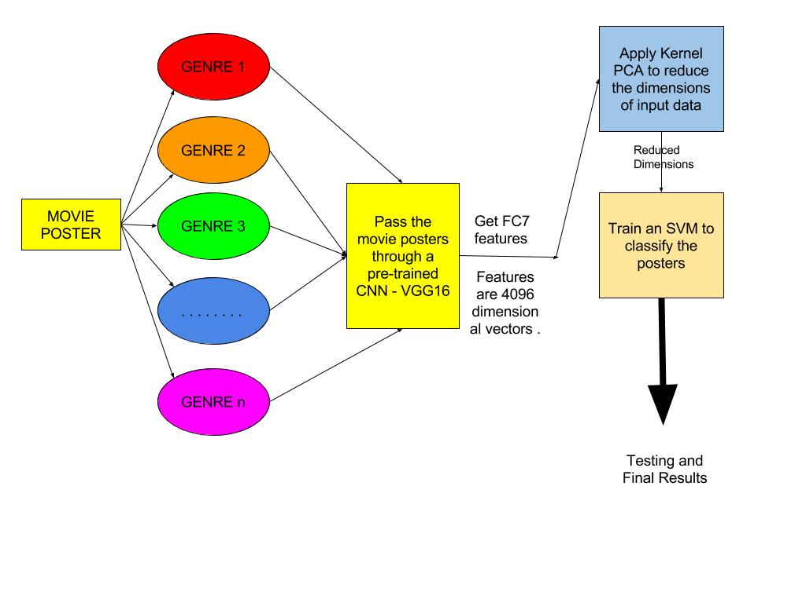
PIPELINE

Slide 4
How to proceed forward ?
STEPS-
Create Dataset - get posters for different genres.
The posters obtained are of different dimensions so each image has to scaled to a uniform 224x224 size
After getting the movie posters, each poster which is a 2-D matrix of size 224x224 is passed through a pre-trained CNN (convolutional neural net)
The features are extracted for each movie poster from the pre-trained CNN.

Slide 5
Steps continued
The dimensions of the extracted features is reduced using Kernel PCA method.
The extracted features after reduced dimensions are sampled into training and testing sets.
The training set is used to train a SVM(support vector machine)
The testing set is then used to predict the genre of the movie from the movie poster and the accuracy of the prediction is calculated.

Slide 6
Detailed Approach - 1. Extracting Movie Posters
So IMDB has detailed information on each movie -
Movie Title (ofcourse :P)
Genre
Rating
Summary
Director
Actors
Movie Poster (VERY IMPORTANT)

Slide 7
Extracting Movie Poster
Extracting the details for each movie other than the poster was easy, which was done using a simple python web crawler script.
Getting the movie posters was the tricky part since IMDB does not allow download of it’s movie poster directly without permission.
After a lot of hunting, managed to find an alternate server which does house the movie posters for the movies on IMDB -
http://www.omdbapi.com/?t=<title of movie>

Slide 8
Final Dataset
IMDB has 21 genres -
Action
Adventure
Animation
Biography
comedy
Crime
documentary
Drama
Family
Fantasy
History
Horror
Music
Musical
mystery
Romance
Sci-fi
Short
Sport
Thriller
War
Western
So for each genre 10,000 movie posters and the other information was collected.

Slide 9
Exercise for all

Slide 10
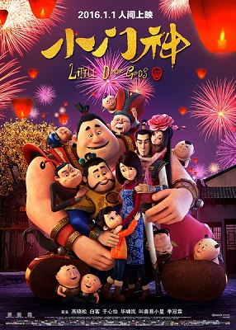


Predict the genre’s

Slide 11
Answers
Animation Comedy Action

Slide 12


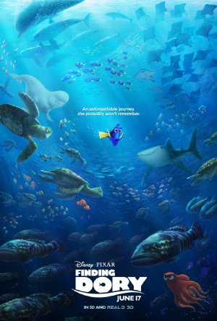
Predict the genre’s

Slide 13
Answers
Comedy Action Animation

Slide 14



Predict the genre’s

Slide 15
Answers
Animation Action Biography

Slide 16



Predict the genre’s

Slide 17
Answers
Biography Animation, Adventure Animation

Slide 18
2. Preprocessing and Extracting CNN Features
The movie posters downloaded from IMDB are of various sizes in the range of (300x400). Before processing the data further each poster was resized to 224x224.
Each poster is a 2-D matrix of size 224x224 which is then passed through a pre-trained CNN (VGG16 in this case) and a 1-D vector of size 4096 is obtained.
VGG16 is a convolutional neural network model proposed by K. Simonyan and A. Zisserman from the University of Oxford.
The model achieves 92.7% top-5 test accuracy in ImageNet , which is a dataset of over 14 million images belonging to 1000 classes.

Slide 19
2. Preprocessing and Extracting CNN features
The weights for the pre-trained VGG16 network were downloaded from a model used for Caffe.
The model was loaded and the FC7 features were extracted by passing it through the network.
The above code was written using python and the TensorFlow library for python

Slide 20
3. Reducing the dimensions of the feature vectors
KERNEL PCA to the rescue.
Each 4096 dimensional feature vector was reduced to a smaller dimensional vector after Principle Component Analysis.

Slide 21
Principle Component Analysis
PCA assumes that the information is carried in the variance of the features, i.e., higher variance of features implies more information (more Entropy).
The idea is to find a lower dimensional projection of data while “preserving most of the variance of data”.
The variance is preserved in the least square sense, i.e., sum of least square error between original data points and their projection is minimized.

Slide 22
Kernel PCA
Compute nxn Gram Matrix K using any kernel function.
Compute eigen-(values/vectors) or K as λ_{j}, ⍺^{j} for all j = 1:m
Normalize the eigen vectors : ⍺^{j} = ⍺^{j} / λ_{j} such that eigen vector of C matrix is: w^{l} = Σ ⍺^{l} Φ(x)
Project any data point Φ(x) onto w^{l} as :
Φ(x)^{T}.w^{l} = Φ(x)^{T}.Σ ⍺^{l} Φ(x)

Slide 23
4. What we get from PCA ?
Applying Kernel PCA on the 4096 dimensional vectors gives us reduced dimensional vectors for each movie poster.

Slide 24
5. Classifying using SVM
The dataset is divided into 70% training images and 30% testing images.
The reduced vectors are used to train an SVM.
After training the testing is done and accuracy is obtained.
For this the scikit-learn python library is used.

Slide 25
Current Results
Presently I have used just 5 genres -
Action
Adventure
Animation
Biography
Comedy

Slide 26
 | Number of Genre | Number of Training Images | Number of Testing Images | Hits | Accuracy %
Action, Adventure | 2 | 200 | 200 | 118 | 59.0
Action, Adventure | 2 | 1000 | 1000 | 621 | 62.1
Action, Adventure, Animation | 3 | 300 | 300 | 170 | 56.67
Action, Adventure, Animation | 3 | 600 | 600 | 368 | 61.33
Above 3 + Biography | 4 | 400 | 400 | 218 | 54.5
Above 3 + Biography | 4 | 800 | 800 | 503 | 62.875
Above 4 + Comedy | 5 | 500 | 500 | 234 | 46.8
Above 4 + Comedy | 5 | 2000 | 2000 | 1185 | 59.25
Results

Slide 27
Confusion Matrices 1
 |  | PREDICTED
ACTUAL |  | ACTION | ADVENTURE
 | ACTION | 60 | 40
 | ADVENTURE | 42 | 58

Slide 28
Confusion Matrices 3
 |  | PREDICTED
ACTUAL |  | ACTION | ADVENTURE | ANIMATION
 | ACTION | 58 | 31 | 11
 | ADVENTURE | 40 | 47 | 13
 | ANIMATION | 11 | 24 | 65

Slide 29
Confusion Matrices 5
 |  | PREDICTED
ACTUAL |  | ACTION | ADVENTURE | ANIMATION | BIOGRAPHY
 | ACTION | 43 | 28 | 5 | 24
 | ADVENTURE | 26 | 47 | 10 | 17
 | ANIMATION | 10 | 26 | 60 | 4
 | BIOGRAPHY | 16 | 15 | 1 | 68

Slide 30
Confusion Matrices 7
 |  | PREDICTED
ACTUAL |  | ACTION | ADVENTURE | ANIMATION | BIOGRAPHY | COMEDY
 | ACTION | 38 | 32 | 5 | 19 | 6
 | ADVENTURE | 23 | 43 | 10 | 9 | 15
 | ANIMATION | 10 | 20 | 58 | 3 | 9
 | BIOGRAPHY | 16 | 11 | 0 | 58 | 15
 | COMEDY | 12 | 17 | 14 | 20 | 37

Slide 31
Future Work
Immediate Goal
Train on more data and get results for the same.
Train on more categories and get results.
Train machines to do classification/prediction using CNNs
Mid-Term Goal
Understand what the CNNs see.
Feature Visualization
Learning the correlations
Long-Term Goal

Slide 32
Source Code -
Source code can be found at github -
https://github.com/sidgairo18/Movie-Genre-Classification-from-Movie-Poster

Slide 33
Thank You :)

